Slide 1
Generating Inputs to the TDOA simulator
By Andrew DeVries
Progress Report 10/22

Slide 2
Inputs:
1: Array of Latitudes, Longitudes and Elevations for G ground stations
2. Array of Latitude, Longitude, Elevation and Time Sync Errors for G ground stations
3. Array of Latitudes, Longitudes and Elevations for S satellites
4. Array of Latitude, Longitude and Elevation Errors for S satellites
Fields: lat, long, elev, lat_er, long_er, elev_er, coord[1x3], coord_er[1x3], clk
getStruct.m
geo2rect.m
[X Y Z], [Xerror Yerror Zerror]
GND (1xG ground stations)
SAT (1xS satellites)
Distances between each ground station and the satellite (also input clk)
timeDiff.m
Loop through each Ground Station Pair for every satellite
gnd2sat.m
Time Differences for each pair for each satellite
dist2time.m
Outputs:
1: Time Differences
2: Time Difference Errors

Slide 3
S1
Lat, Lat error [deg]
Long, Long error [deg]
Elev, Elev error [m]
Inputs:
A
Lat, Lat error [deg]
Long, Long error [deg]
Elev, Elev error [m]
Clk sync [s]
C
Lat, Lat error [deg]
Long, Long error [deg]
Elev, Elev error [m]
Clk sync [s]
S2
Lat, Lat error [deg]
Long, Long error [deg]
Elev, Elev error [m]
B
Lat, Lat error [deg]
Long, Long error [deg]
Elev, Elev error [m]
Clk sync [s]
D
Lat, Lat error [deg]
Long, Long error [deg]
Elev, Elev error [m]
Clk sync [s]

Slide 4
All information captured in GND structure!
A
Lat, Lat error [deg]
Long, Long error [deg]
Elev, Elev error [m]
Clk sync
C
Lat, Lat error [deg]
Long, Long error [deg]
Elev, Elev error [m]
Clk sync
B
Lat, Lat error [deg]
Long, Long error [deg]
Elev, Elev error [m]
Clk sync
D
Lat, Lat error [deg]
Long, Long error [deg]
Elev, Elev error [m]
Clk sync

Slide 5
S1
Lat, Lat error [deg]
Long, Long error [deg]
Elev, Elev error [m]
All information captured in SAT structure!
S2
Lat, Lat error [deg]
Long, Long error [deg]
Elev, Elev error [m]

Slide 6
Outputs: Time Difference Matrix
S1
S2
…
SN
Time Difference [s]
A-B
A-B error
A-C
A-C error
A-D
A-D error
B-C
B-C error
B-D
B-D error
C-D
C-D error
A-B
A-B error
A-C
A-C error
A-D
A-D error
B-C
B-C error
B-D
B-D error
C-D
C-D error
A-B
A-B error
A-C
A-C error
.
.
.
.
.
.
(G-1)-G
(G-1)-G error
Time Difference Error [s]
N satellites
G Ground Stations

Slide 7
Notes:
timeDiff can run with any size GND and SAT structures
The coordinate conversion assumes a spherical earth
Satellite position is absolute Lat and Long, not azimuth and elevation
The elevations values are in meters above sea level

Slide 8
The TDoA simulator
By Anthony Iannuzzi
Progress Report 10/22

Slide 9
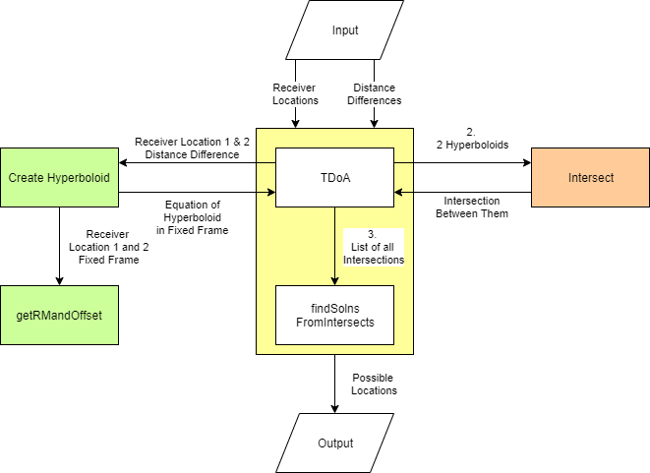
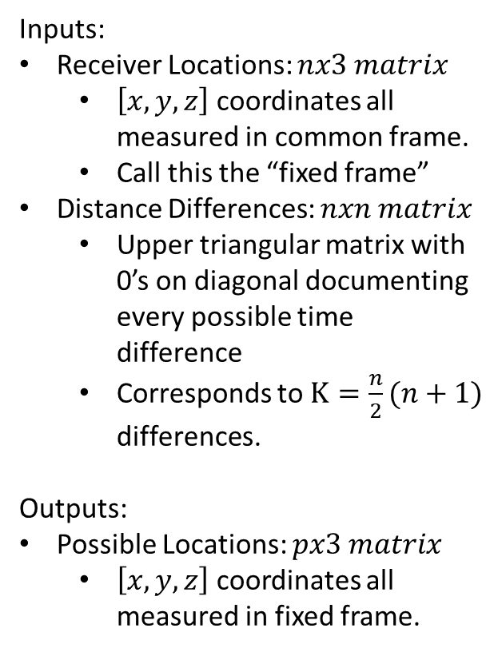
TDoA Simulator High level diagram. I/O
Inputs:
Receiver Locations: $nx3 matrix$
$\left[x,y,z\right]$ coordinates all measured in common frame.
Call this the “fixed frame”
Distance Differences: $nxn matrix$
Upper triangular matrix with 0’s on diagonal documenting every possible time difference
Corresponds to $K=\frac{n}{2}(n+1)$ differences.
Outputs:
Possible Locations: $px3 matrix$
$\left[x,y,z\right]$ coordinates all measured in fixed frame.

Slide 10
TDoA Simulator High level diagram. Algorithm
Create K hyperboloids in the fixed frame based on every distance difference given.
Get the intersection.
Make a xy offset plane slice of all hyperboloids.
Intersect the resulting hyperbolas 2 at a time.
Chose only nearby points from list of intersections. Those are the possible locations.

Slide 11
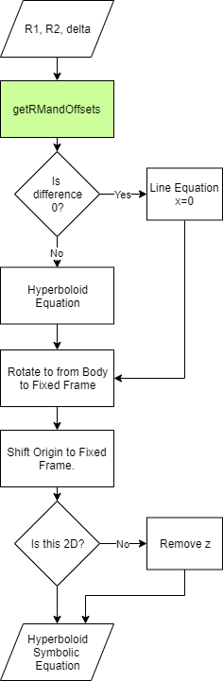
Step 1. Creating Hyperboloids
Inputs:
Receiver Locations in the fixed frame
Distance Difference
Algorithm:
Calculate Coordinate Transformation
Create Hyperboloid in Body Frame.
Transform to Fixed frame.
Outputs:
Symbolic Equation of Hyperboloid

Slide 12







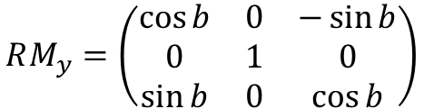

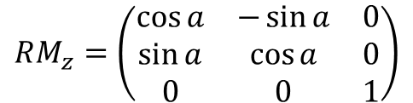
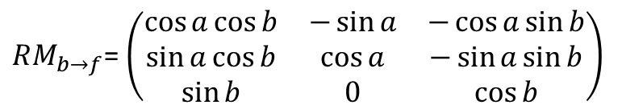


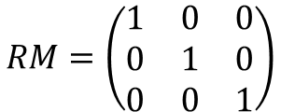






Coordinate Transformation
Azimuth, Elevation Rotations
$$k$$
$$k$$
$$k′$$
$$k′′$$
$$k$$
$$k′$$
$$j′$$
$$j′′$$
$$j′$$
$$j$$
$$j$$
$$j$$
$$i′′$$
$$i$$
$$i$$
$$i′$$
$$i$$
$$i′$$
Fixed Frame
Intermediate Frame
Body Frame
$$RM=\left(\begin{matrix}1 & 0 & 0 \\ 0 & 1 & 0 \\ 0 & 0 & 1\end{matrix}\right)$$
$$RM_{z}=\left(\begin{matrix}\cos{a} & −\sin{a} & 0 \\ \sin{a} & \cos{a} & 0 \\ 0 & 0 & 1\end{matrix}\right)$$
$$RM_{y}=\left(\begin{matrix}\cos{b} & 0 & −\sin{b} \\ 0 & 1 & 0 \\ \sin{b} & 0 & \cos{b}\end{matrix}\right)$$
$$RM_{b→f}=RM_{z}∗RM_{y}$$
$RM_{b→f}$= $\left(\begin{matrix}\cos{a}\cos{b} & −\sin{a} & −\cos{a}\sin{b} \\ \sin{a}\cos{b} & \cos{a} & −\sin{a}\sin{b} \\ \sin{b} & 0 & \cos{b}\end{matrix}\right)$
$$r_{f}=RM_{b→f}∗r_{b}$$

Slide 13






Coordinate Transformation
How to calculate Azimuth, Elevation Rotations
$$k$$
$$k$$
$$k′$$
$$k′′$$
$$k$$
$$k′$$
$$j′$$
$$j′′$$
$$j′$$
$$j$$
$$j$$
$$(x_{s},y_{s},z_{s})$$
$$j$$
$$i′′$$
$$i$$
$$i$$
$$i′$$
$$i$$
$$i′$$
Fixed Frame
Intermediate Frame
Body Frame
$$Given:\left[x_{s},y_{s},z_{s}\right]$$
$$a=\tan^{−1}{\frac{y_{s}}{x_{s}}}$$
$$b=\tan^{−1}{\frac{z_{s}}{\sqrt{x_{s}^{2}+y_{s}^{2}}}}$$
$$RM_{b→f}=RM_{z}∗RM_{y}$$
$RM_{b→f}$= $\left(\begin{matrix}\cos{a}\cos{b} & −\sin{a} & −\cos{a}\sin{b} \\ \sin{a}\cos{b} & \cos{a} & −\sin{a}\sin{b} \\ \sin{b} & 0 & \cos{b}\end{matrix}\right)$
$$r_{f}=RM_{b→f}∗r_{b}$$

Slide 14












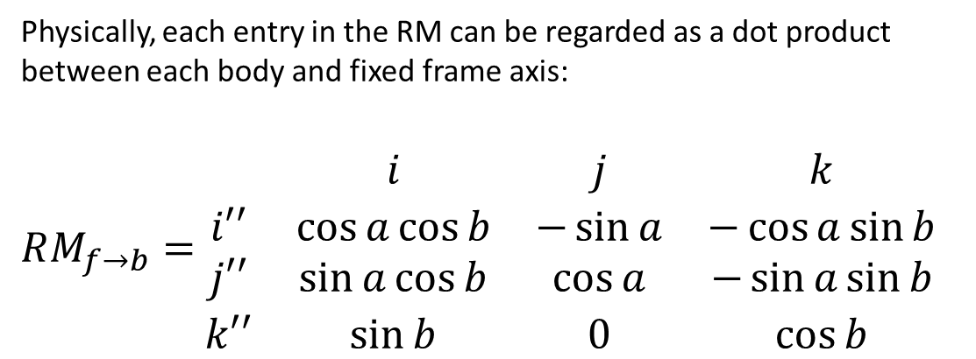
Coordinate Transformation
Offset and Rotation
$$k$$
Rotate to the Fixed coordinate frame.
Then shift coordinate frame.
Fixed Frame
Intermediate Frame
$$k′′$$
Body Frame
$$Given: P=\left[x_{0},y_{0},z_{0}\right]$$
$$k$$
$$j′′$$
$$r_{f}=RM_{b→f}∗r_{b}−P$$
$$j$$
$$(x_{0},y_{0},z_{0})$$
$$j$$
Physically, each entry in the RM can be regarded as a dot product between each body and fixed frame axis:
$RM_{f→b}=$ $\begin{matrix} & i & j & k \\ i′′ & \cos{a}\cos{b} & −\sin{a} & −\cos{a}\sin{b} \\ j′′ & \sin{a}\cos{b} & \cos{a} & −\sin{a}\sin{b} \\ k′′ & \sin{b} & 0 & \cos{b}\end{matrix}$
$$i$$
$$i$$
$$i′′$$

Slide 15
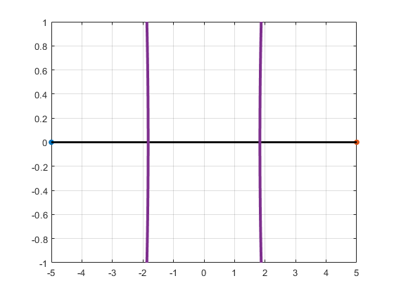



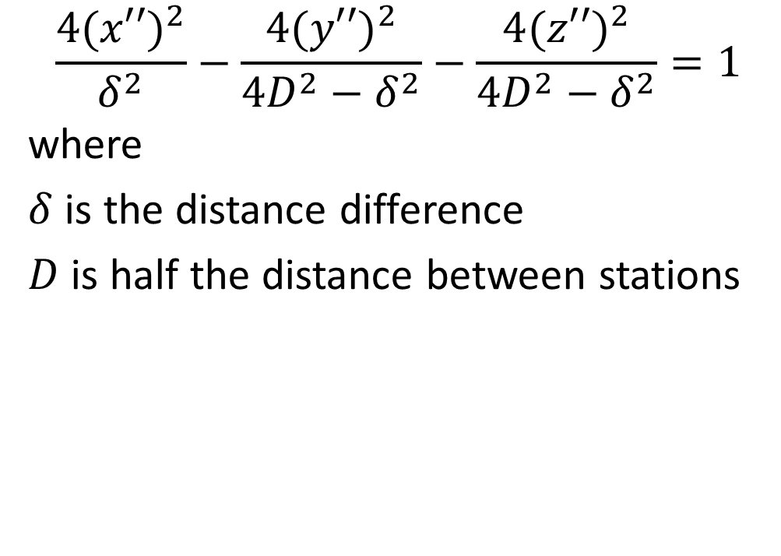





Hyperboloid in Body Frame
$$\frac{4{(x′′)}^{2}}{δ^{2}}−\frac{4{(y′′)}^{2}}{4D^{2}−δ^{2}}−\frac{4{(z′′)}^{2}}{4D^{2}−δ^{2}}=1$$
where
$δ$ is the distance difference
$D$ is half the distance between stations
$$δ=5(\sqrt{3}−1)$$
$$j′′$$
$$(−D,0,0)$$
$Station$2
$$(−D,0,0)$$
$$O$$
$$Station 1$$
$$i′′$$
$$(D,0,0)$$

Slide 16
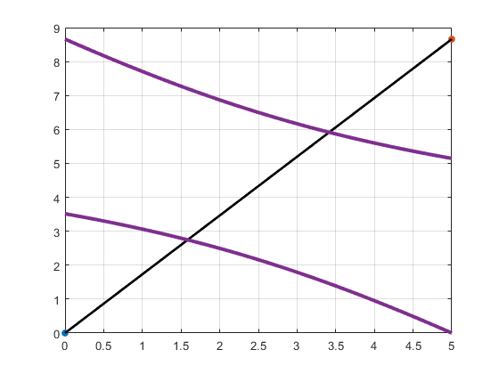


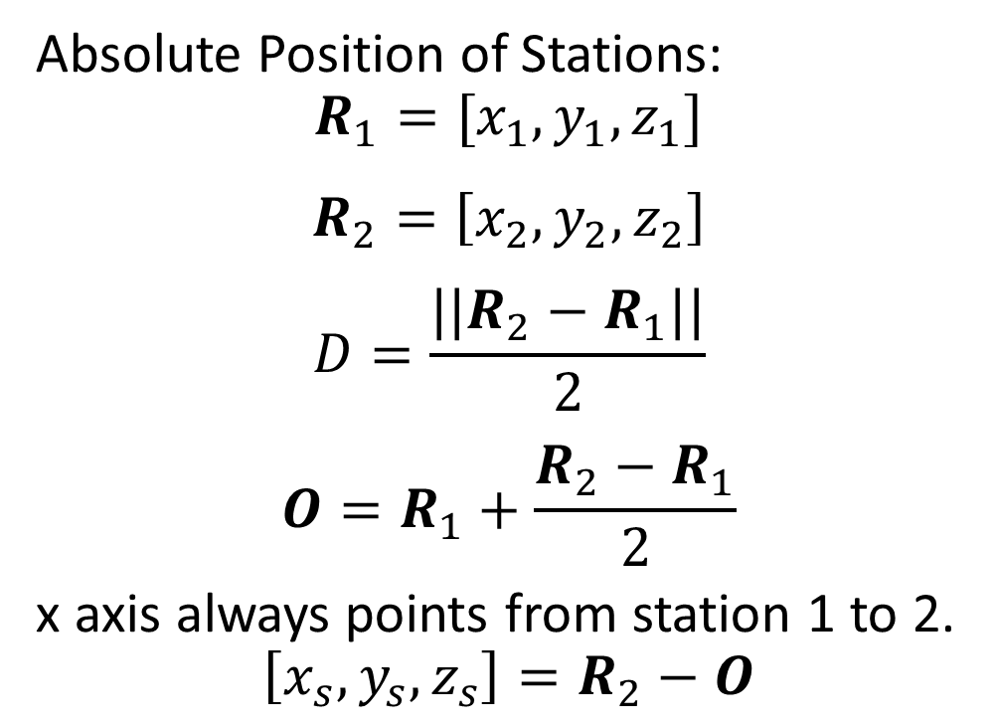





Hyperboloid in Fixed Frame
Absolute Position of Stations:
$$R_{1}=[x_{1},y_{1},z_{1}]$$
$$R_{2}=\left[x_{2},y_{2},z_{2}\right]$$
$$D=\frac{||R_{2}−R_{1}||}{2}$$
$$O=R_{1}+\frac{R_{2}−R_{1}}{2}$$
x axis always points from station 1 to 2.
$$\left[x_{s},y_{s},z_{s}\right]=R_{2}−O$$
$$R_{2}$$
$$δ=5(\sqrt{3}−1)$$
$$j′′$$
$$i′′$$
$$O$$
$$D$$
$$R_{1}$$

Slide 17
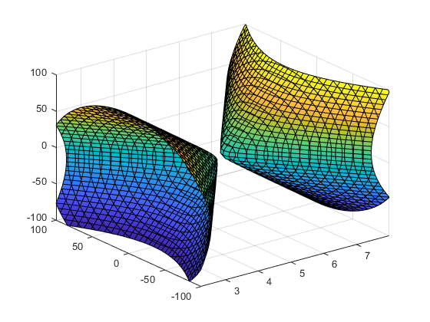



Hyperboloid in Fixed Frame
Let $r={\left[x−x_{0},y−y_{0},z−z_{0}\right]}^{T}$
$$\frac{4{(r∙RM(:,1))}^{2}}{δ^{2}}−\frac{4{(r∙RM\left(:,2\right))}^{2}}{4D^{2}−δ^{2}}−\frac{4{(r∙RM\left(:,3\right))}^{2}}{4D^{2}−δ^{2}}=1$$
Substitute $\left[x^{′′},y^{′′},z^{′′}\right] for r$
Result is Equation of Hyperboloid in
fixed frame.
$Station$2
$$δ=5(\sqrt{3}−1)$$
$$j′′$$
$$i′′$$
$$O$$
$$D$$
$$Station 1$$

Slide 18
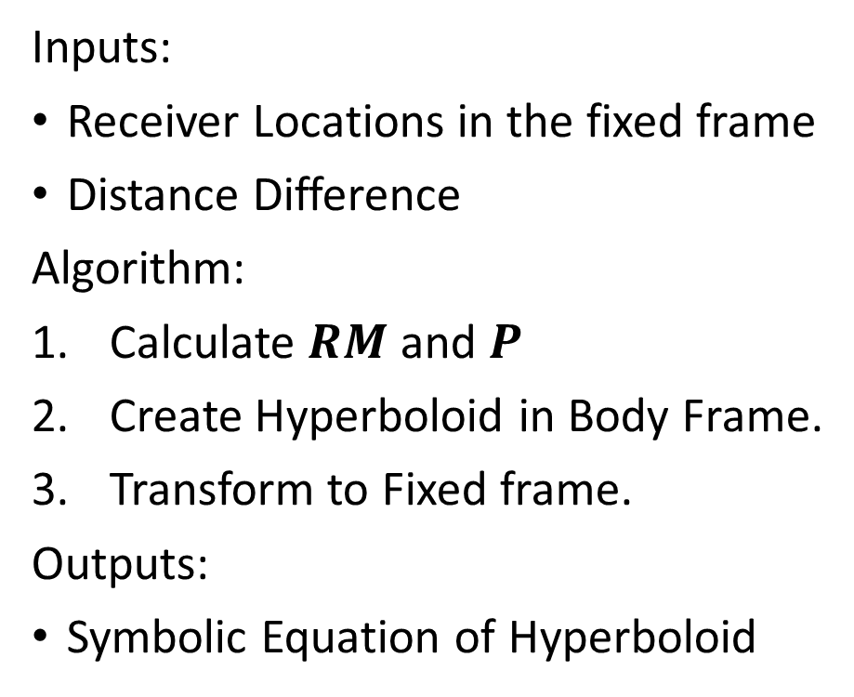
Creating Hyperboloids Recap
Inputs:
Receiver Locations in the fixed frame
Distance Difference
Algorithm:
Calculate $RM$ and $P$
Create Hyperboloid in Body Frame.
Transform to Fixed frame.
Outputs:
Symbolic Equation of Hyperboloid

Slide 19
Step 2. Intersection
Create K hyperboloids in the fixed frame based on every distance difference given.
Get the intersection.
Make a xy offset plane slice of all hyperboloids.
Intersect the resulting hyperbolas 2 at a time.
Chose only nearby points from list of intersections. Those are the possible locations.

Slide 20
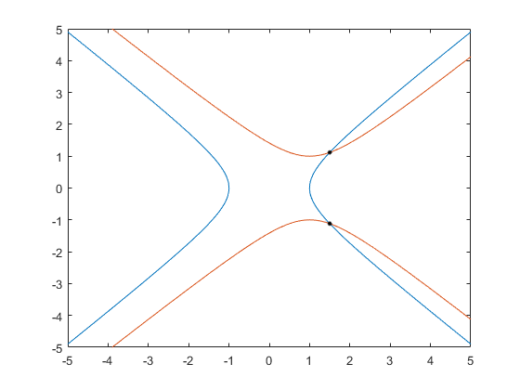
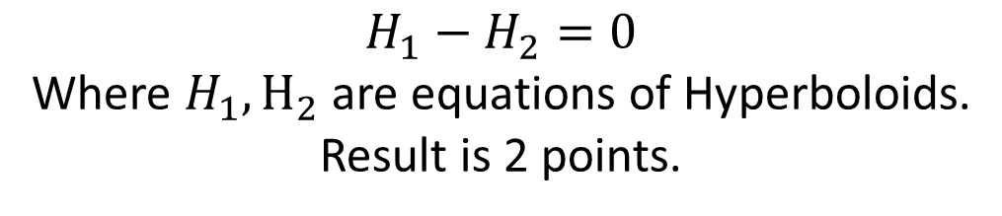
Intersecting 2 Surfaces 2D
$$H_{1}−H_{2}=0$$
Where $H_{1},H_{2}$ are equations of Hyperboloids.
Result is 2 points.

Slide 21
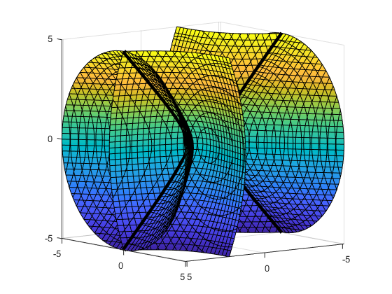
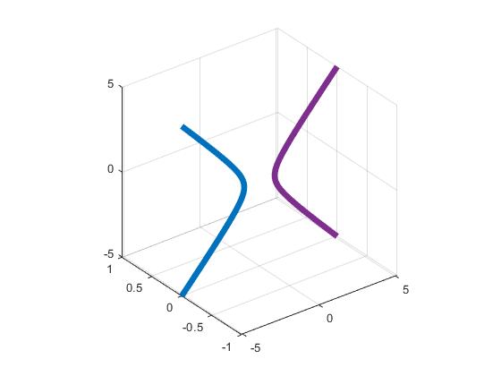
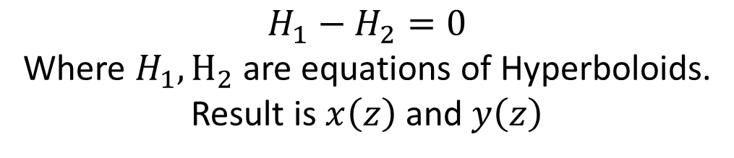
Intersecting 2 Surfaces 3D
$$H_{1}−H_{2}=0$$
Where $H_{1},H_{2}$ are equations of Hyperboloids.
Result is $x\left(z\right)$ and $y\left(z\right)$

Slide 22
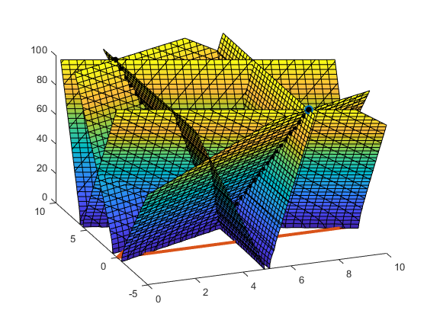
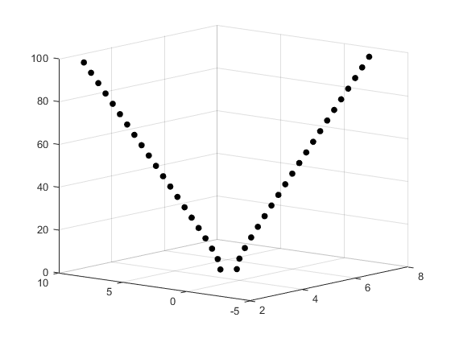
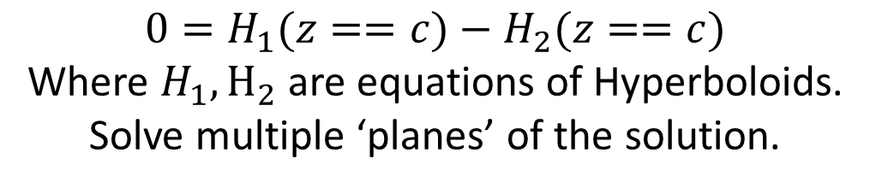
Approximating 3D Intersection
Further from foci, the hyperboloids look more like planes.
Approximately Linear Region
$$0=H_{1}(z==c)−H_{2}(z==c)$$
Where $H_{1},H_{2}$ are equations of Hyperboloids.
Solve multiple ‘planes’ of the solution.

Slide 23
Step 3. Choose the “Best” Solution
Create K hyperboloids in the fixed frame based on every distance difference given.
Get the intersection.
Make a xy offset plane slice of all hyperboloids.
Intersect the resulting hyperbolas 2 at a time.
Chose only nearby points from list of intersections. Those are the possible locations.

Slide 24
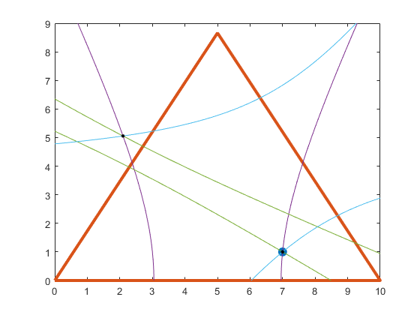
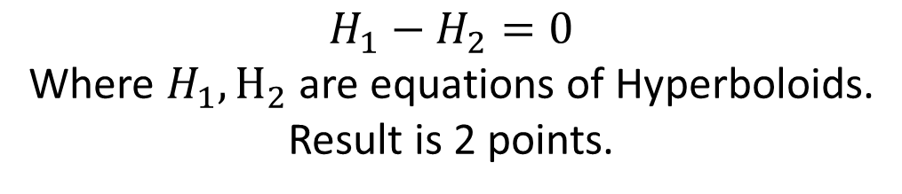
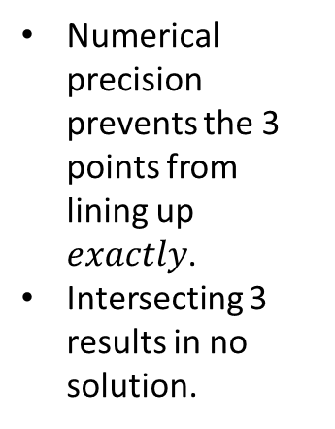
Intersecting 3 hyperbolas 3 times
1 | 7.0001 | 0.9998
 | 7.1886 | 2.3197
 | 2.4457 | 3.8727
 | 2.0964 | 5.0562
2 | 1.9290 | -5.5781
 | 7.0000 | 1.0001
 | 2.0963 | 5.0564
 | 9.3175 | 9.0656
3 | 6.9888 | 0.9970
 | 8.0753 | 1.8799
 | 0.6839 | 4.8581
 | 2.0965 | 5.0565
Numerical precision prevents the 3 points from lining up $exactly$.
Intersecting 3 results in no solution.
$$H_{1}−H_{2}=0$$
Where $H_{1},H_{2}$ are equations of Hyperboloids.
Result is 2 points.

Slide 25
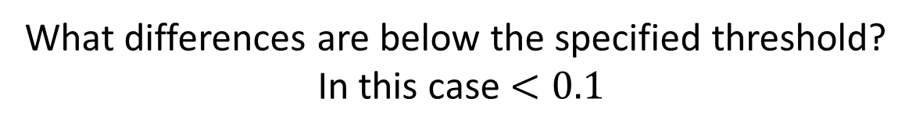
Getting the ‘Best’ estimate
 | x sorted | y sorted | difference | difference
1 | 0.6839 | 4.8581 | 1.2451 | -10.4362
2 | 1.9290 | -5.5781 | 0.1673 | 10.6345
3 | 2.0963 | 5.0564 | 0.0001 | -0.0002
4 | 2.0964 | 5.0562 | 0.0001 | 0.0003
5 | 2.0965 | 5.0565 | 0.3492 | -1.1838
6 | 2.4457 | 3.8727 | 4.5431 | -2.8757
7 | 6.9888 | 0.9970 | 0.0112 | 0.0031
8 | 7.0000 | 1.0001 | 0.0001 | -0.0003
9 | 7.0001 | 0.9998 | 0.1885 | 1.3199
10 | 7.1886 | 2.3197 | 0.8866 | -0.4399
11 | 8.0753 | 1.8799 | 1.2423 | 7.1858
12 | 9.3175 | 9.0656
What differences are below the specified threshold?
In this case $<0.1$

Slide 26
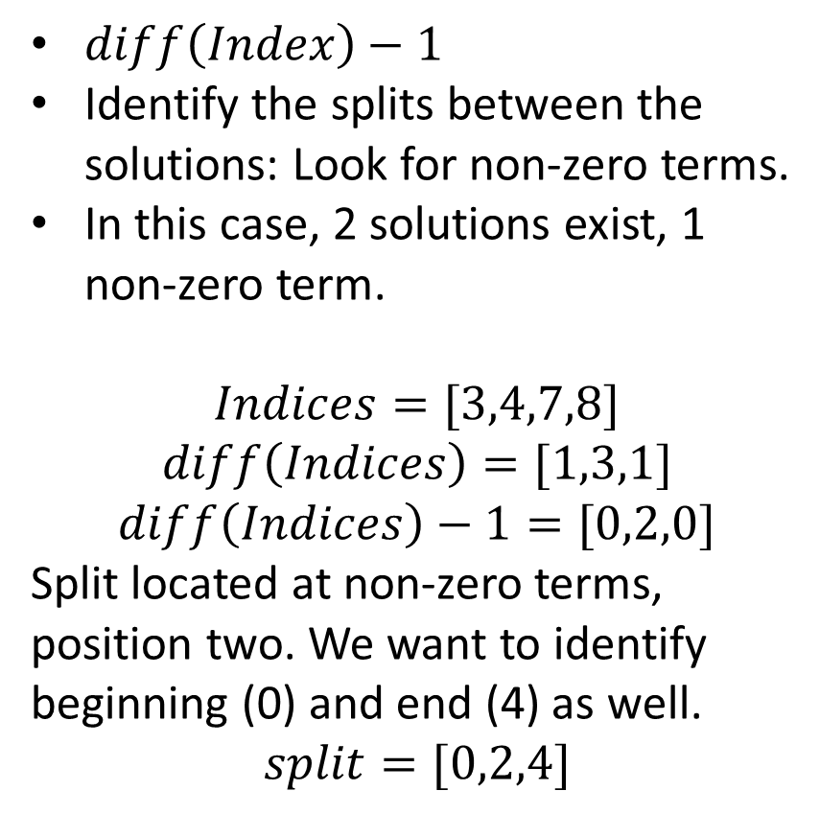
Getting the ‘Best’ estimate
Index | Diff - 1 | x sorted | y sorted | difference | difference
1 |  | 0.6839 | 4.8581 | 1.2451 | -10.4362
2 |  | 1.9290 | -5.5781 | 0.1673 | 10.6345
3 | 0 | 2.0963 | 5.0564 | 0.0001 | -0.0002
4 | 2 | 2.0964 | 5.0562 | 0.0001 | 0.0003
5 |  | 2.0965 | 5.0565 | 0.3492 | -1.1838
6 |  | 2.4457 | 3.8727 | 4.5431 | -2.8757
7 | 0 | 6.9888 | 0.9970 | 0.0112 | 0.0031
8 |  | 7.0000 | 1.0001 | 0.0001 | -0.0003
9 | 0 | 7.0001 | 0.9998 | 0.1885 | 1.3199
10 |  | 7.1886 | 2.3197 | 0.8866 | -0.4399
11 |  | 8.0753 | 1.8799 | 1.2423 | 7.1858
12 |  | 9.3175 | 9.0656
$diff\left(Index\right)−1$
Identify the splits between the solutions: Look for non-zero terms.
In this case, 2 solutions exist, 1 non-zero term.
$$Indices=[3,4,7,8]$$
$$diff\left(Indices\right)=[1,3,1]$$
$$diff\left(Indices\right)−1=[0,2,0]$$
Split located at non-zero terms, position two. We want to identify beginning (0) and end (4) as well.
$$split=[0,2,4]$$

Slide 27
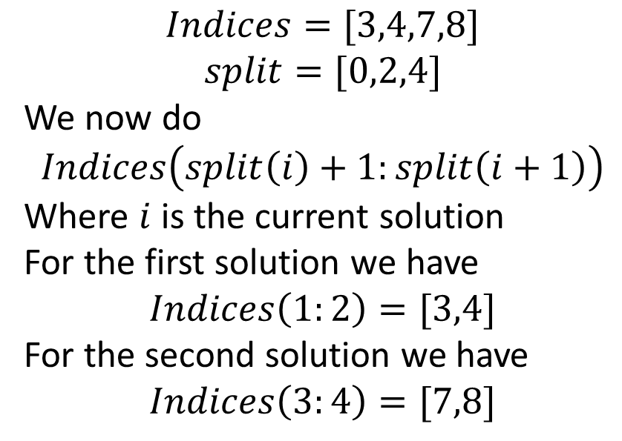
Getting the ‘Best’ estimate
Index | Diff - 1 | x sorted | y sorted | difference | difference
1 |  | 0.6839 | 4.8581 | 1.2451 | -10.4362
2 |  | 1.9290 | -5.5781 | 0.1673 | 10.6345
3 | 0 | 2.0963 | 5.0564 | 0.0001 | -0.0002
4 | 2 | 2.0964 | 5.0562 | 0.0001 | 0.0003
5 |  | 2.0965 | 5.0565 | 0.3492 | -1.1838
6 |  | 2.4457 | 3.8727 | 4.5431 | -2.8757
7 | 0 | 6.9888 | 0.9970 | 0.0112 | 0.0031
8 |  | 7.0000 | 1.0001 | 0.0001 | -0.0003
9 |  | 7.0001 | 0.9998 | 0.1885 | 1.3199
10 |  | 7.1886 | 2.3197 | 0.8866 | -0.4399
11 |  | 8.0753 | 1.8799 | 1.2423 | 7.1858
12 |  | 9.3175 | 9.0656
$$Indices=[3,4,7,8]$$
$$split=[0,2,4]$$
We now do
$$Indices\left(split\left(i\right)+1:split\left(i+1\right)\right)$$
Where $i$ is the current solution
For the first solution we have
$$Indices\left(1:2\right)=[3,4]$$
For the second solution we have
$$Indices\left(3:4\right)=[7,8]$$

Slide 28
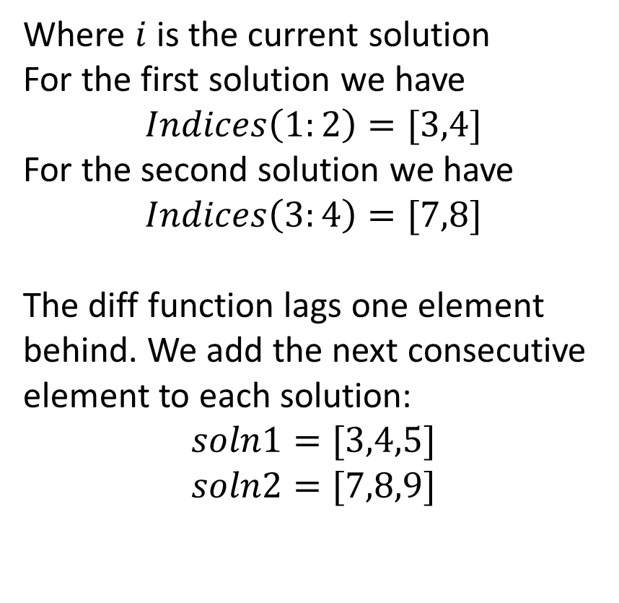
Getting the ‘Best’ estimate
Index | Diff - 1 | x sorted | y sorted | difference | difference
1 |  | 0.6839 | 4.8581 | 1.2451 | -10.4362
2 |  | 1.9290 | -5.5781 | 0.1673 | 10.6345
3 | 0 | 2.0963 | 5.0564 | 0.0001 | -0.0002
4 | 2 | 2.0964 | 5.0562 | 0.0001 | 0.0003
5 |  | 2.0965 | 5.0565 | 0.3492 | -1.1838
6 |  | 2.4457 | 3.8727 | 4.5431 | -2.8757
7 | 0 | 6.9888 | 0.9970 | 0.0112 | 0.0031
8 |  | 7.0000 | 1.0001 | 0.0001 | -0.0003
9 |  | 7.0001 | 0.9998 | 0.1885 | 1.3199
10 |  | 7.1886 | 2.3197 | 0.8866 | -0.4399
11 |  | 8.0753 | 1.8799 | 1.2423 | 7.1858
12 |  | 9.3175 | 9.0656
Where $i$ is the current solution
For the first solution we have
$$Indices\left(1:2\right)=[3,4]$$
For the second solution we have
$$Indices\left(3:4\right)=[7,8]$$
The diff function lags one element behind. We add the next consecutive element to each solution:
$$soln1=[3,4,5]$$
$$soln2=[7,8,9]$$

Slide 29


Getting the ‘Best’ estimate
Index | Diff - 1 | x sorted | y sorted | difference | difference
1 |  | 0.6839 | 4.8581 | 1.2451 | -10.4362
2 |  | 1.9290 | -5.5781 | 0.1673 | 10.6345
3 | 0 | 2.0963 | 5.0564 | 0.0001 | -0.0002
4 | 2 | 2.0964 | 5.0562 | 0.0001 | 0.0003
5 |  | 2.0965 | 5.0565 | 0.3492 | -1.1838
6 |  | 2.4457 | 3.8727 | 4.5431 | -2.8757
7 | 0 | 6.9888 | 0.9970 | 0.0112 | 0.0031
8 |  | 7.0000 | 1.0001 | 0.0001 | -0.0003
9 |  | 7.0001 | 0.9998 | 0.1885 | 1.3199
10 |  | 7.1886 | 2.3197 | 0.8866 | -0.4399
11 |  | 8.0753 | 1.8799 | 1.2423 | 7.1858
12 |  | 9.3175 | 9.0656
Now average the solution together.
$$(2.0964,5.05637)$$
$$(6.9963,0.999)$$

Slide 30
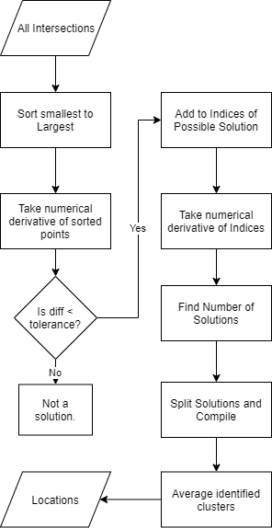
Choose the “Best” Solution Flowchart

Slide 31
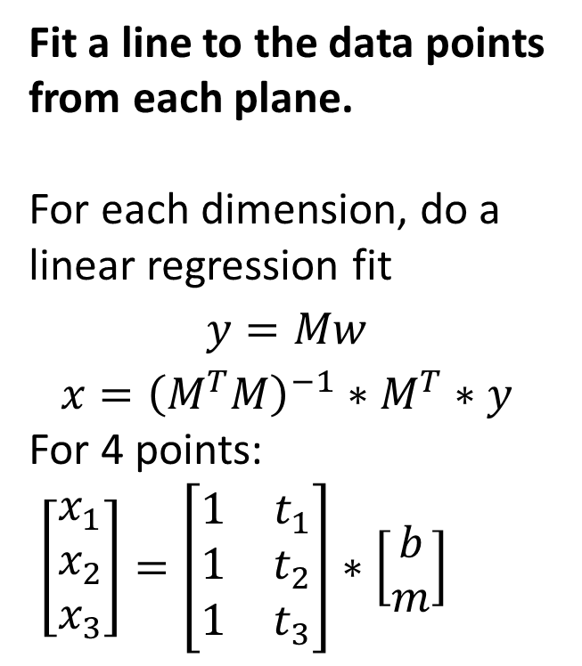
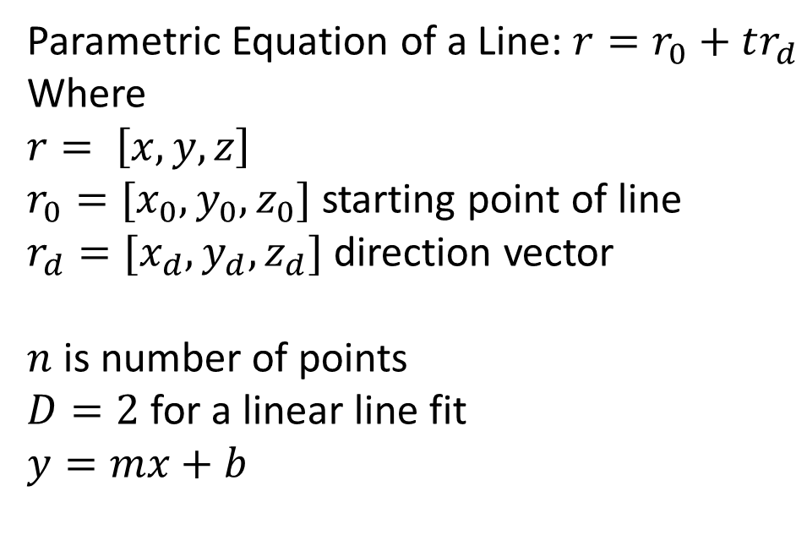



Points on Planes to a Line Fit.
Fit a line to the data points from each plane.
For each dimension, do a linear regression fit
$$y=Mw$$
$$x={\left(M^{T}M\right)}^{−1}∗M^{T}∗y$$
For 4 points:
$\left[\begin{matrix}x_{1} \\ x_{2} \\ x_{3}\end{matrix}\right]=\left[\begin{matrix}1 & t_{1} \\ 1 & t_{2} \\ 1 & t_{3}\end{matrix}\right]∗\left[\begin{matrix}b \\ m\end{matrix}\right]$
Parametric Equation of a Line: $r=r_{0}+tr_{d}$
Where
$$r= \left[x,y,z\right]$$
$r_{0}=[x_{0},y_{0},z_{0}]$ starting point of line
$r_{d}=[x_{d},y_{d},z_{d}]$ direction vector
$n$ is number of points
$D=2$ for a linear line fit
$$y=mx+b$$
$$nx1$$
$$nxD$$
$$Dx1$$

Slide 32
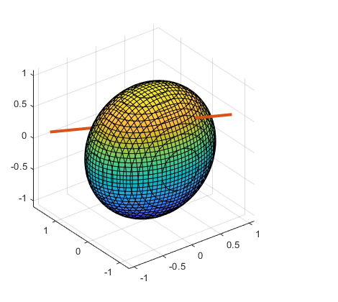
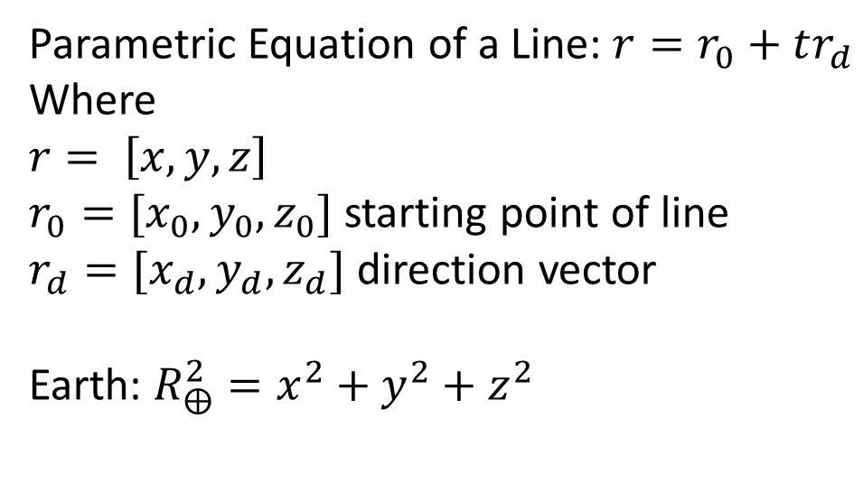
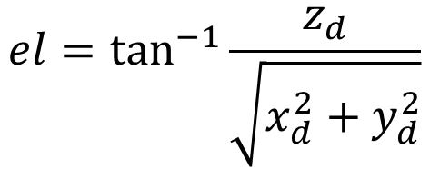
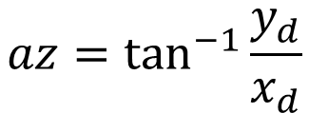
Line to Azimuth and Elevation.
Parametric Equation of a Line: $r=r_{0}+tr_{d}$
Where
$$r= \left[x,y,z\right]$$
$r_{0}=[x_{0},y_{0},z_{0}]$ starting point of line
$r_{d}=[x_{d},y_{d},z_{d}]$ direction vector
Earth: $R_{⨁}^{2}=x^{2}+y^{2}+z^{2}$
Intersect Line and Earth Model
Earth is sphere.
Constitutes our “reference frame location”
Convert Line direction vector to Azimuth and Elevation
$$az=\tan^{−1}{\frac{y_{d}}{x_{d}}}$$
$$el=\tan^{−1}{\frac{z_{d}}{\sqrt{x_{d}^{2}+y_{d}^{2}}}}$$

Slide 33
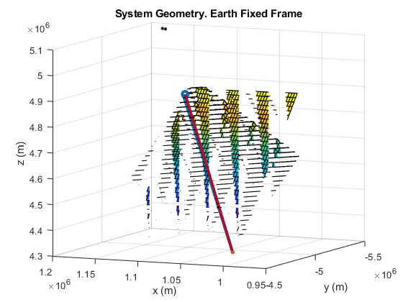
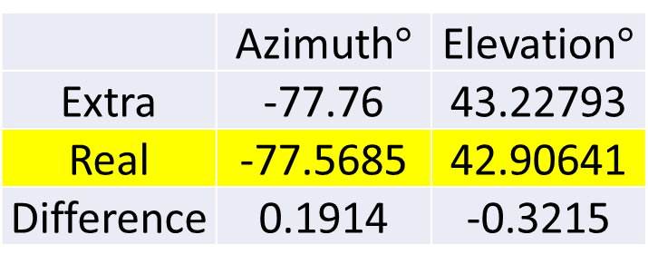
Real Example with Satellite
Satellite located above the Sentinel Statue with altitude 775km
3 Stations located at the Hill, Ellingson, and RIT Inn.
Results:
Line Fit via 3 points.
 | Azimuth$°$ | Elevation$°$
Extra | -77.76 | 43.22793
Real | -77.5685 | 42.90641
Difference | 0.1914 | -0.3215

Slide 34
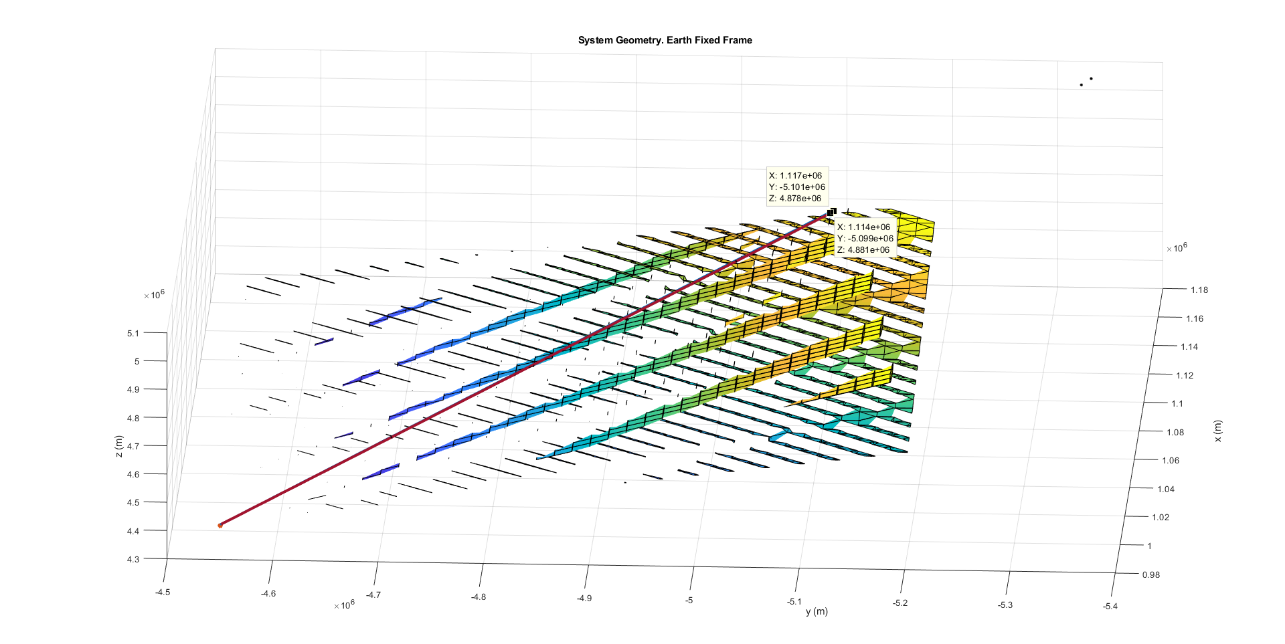
Real Example with Satellite
Matlab appears to have a hard time creating a mesh with these large of numbers.

Slide 35
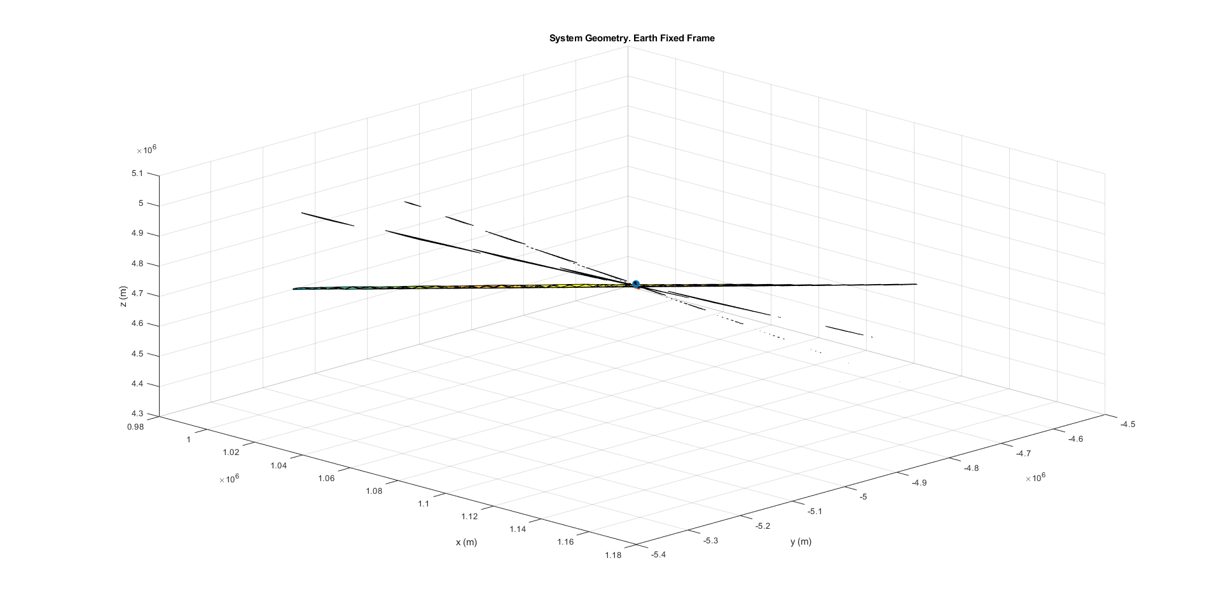
Real Example with Satellite
Hyperboloids look like planes out this far.

Slide 36




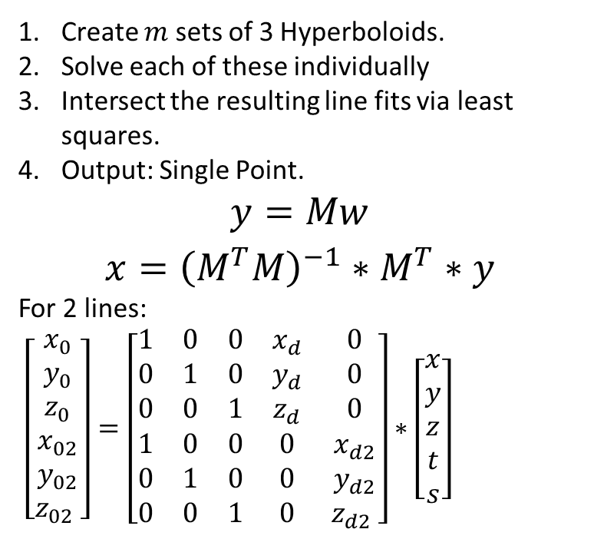

More than 3 base stations.
Create $m$ sets of 3 Hyperboloids.
Solve each of these individually
Intersect the resulting line fits via least squares.
Output: Single Point.
$$y=Mw$$
$$x={\left(M^{T}M\right)}^{−1}∗M^{T}∗y$$
For 2 lines:
$\left[\begin{matrix}x_{0} \\ y_{0} \\ z_{0} \\ x_{02} \\ y_{02} \\ z_{02} \end{matrix}\right]=\left[\begin{matrix}1 & 0 & 0 & x_{d} & 0 \\ 0 & 1 & 0 & y_{d} & 0 \\ 0 & 0 & 1 & z_{d} & 0 \\ 1 & 0 & 0 & 0 & x_{d2} \\ 0 & 1 & 0 & 0 & y_{d2} \\ 0 & 0 & 1 & 0 & z_{d2} \end{matrix}\right]∗\left[\begin{matrix}x \\ y \\ z \\ t \\ s\end{matrix}\right]$
$$3n x 1$$
$$3n x (3+n)$$
$$\left(3+n\right) x 1$$
$$r=r_{0}+tr_{d}$$
$$r_{2}=r_{02}+sr_{d2}$$

Slide 37
Preliminary Sensitivity Analysis
Progress Report 10/29

Slide 38
More than 3 base stations with small errors.
Poorly Constructed problem.
Slopes of each line are too similar – near parallel.
Slight deviations result in huge errors.
 | No error | 0.001% Location Err. | 2% Time Error
Position Err. (m) | 625 | 256,000 | 16,000

Slide 39
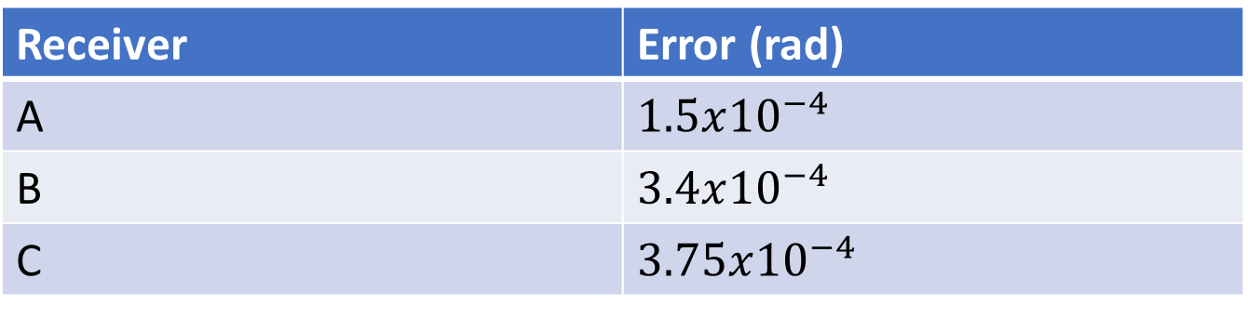
3 Base Stations with small errors.
Satellite is over Sentinel still. Stations are located on Ellingson, The Hill, and RIT Inn.
Time error is 300 picoseconds
Resulting Errors from Time Sync. One at a Time.
Receiver | Error (rad)
A | $1.5x{10}^{−4}$
B | $3.4x{10}^{−4}$
C | $3.75x{10}^{−4}$

Slide 40
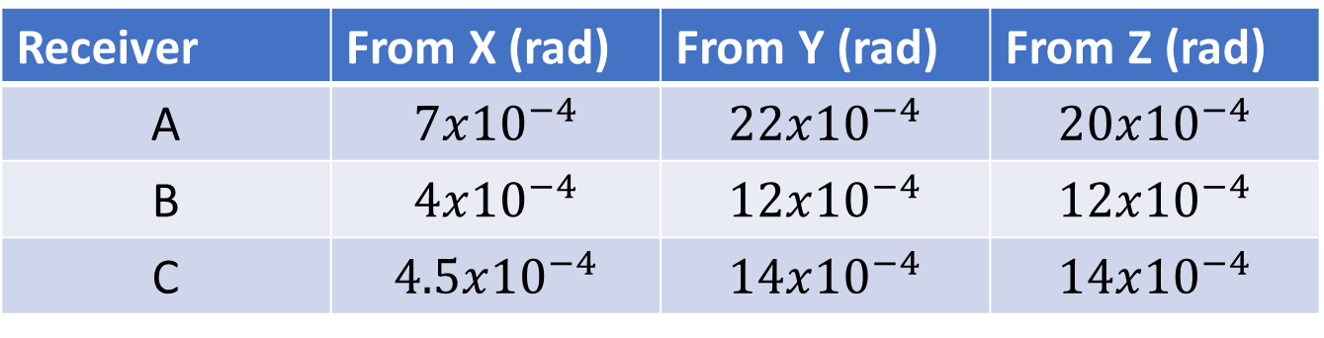
3 Base Stations with small errors.
Location error is Lat: 0.00005 deg, Long: 0.0001 deg, Altitude: 0.9m
Derived Location Error
Receiver | X (m) | Y (m) | Z (m)
A | 7.268079 | 4.798699 | 4.67656
B | 7.2629 | 4.802649 | 4.675313
C | 7.267696 | 4.801882 | 4.677395
Resulting Errors from Location Error. One at a Time.
Receiver | From X (rad) | From Y (rad) | From Z (rad)
A | $$7x{10}^{−4}$$ | $$22x{10}^{−4}$$ | $$20x{10}^{−4}$$
B | $$4x{10}^{−4}$$ | $$12x{10}^{−4}$$ | $$12x{10}^{−4}$$
C | $$4.5x{10}^{−4}$$ | $$14x{10}^{−4}$$ | $$14x{10}^{−4}$$

Slide 41
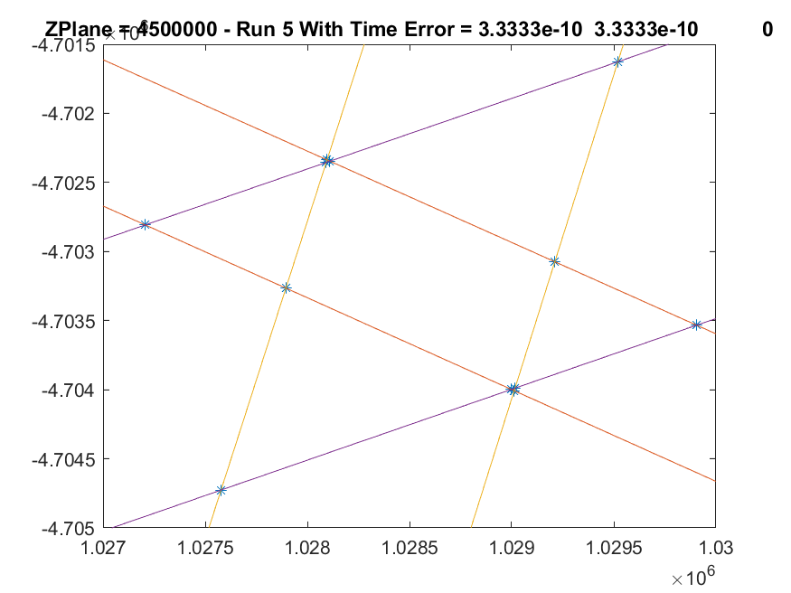
Clock A Error. Press, Pull

Slide 42
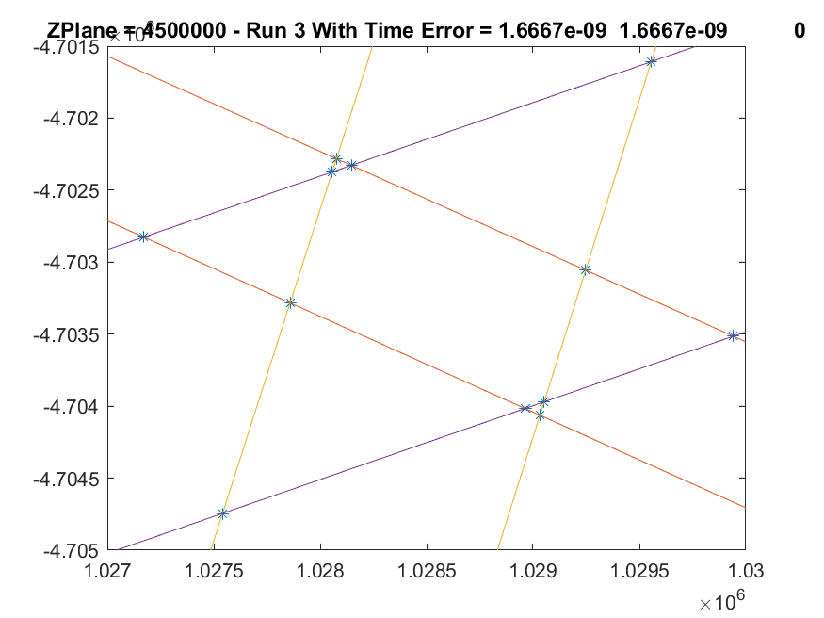
Clock A Error. Press, Pull

Slide 43
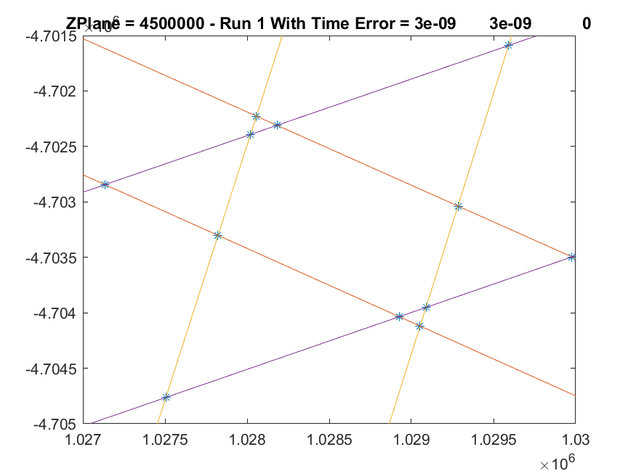
Clock A Error. Press, Pull

Slide 44
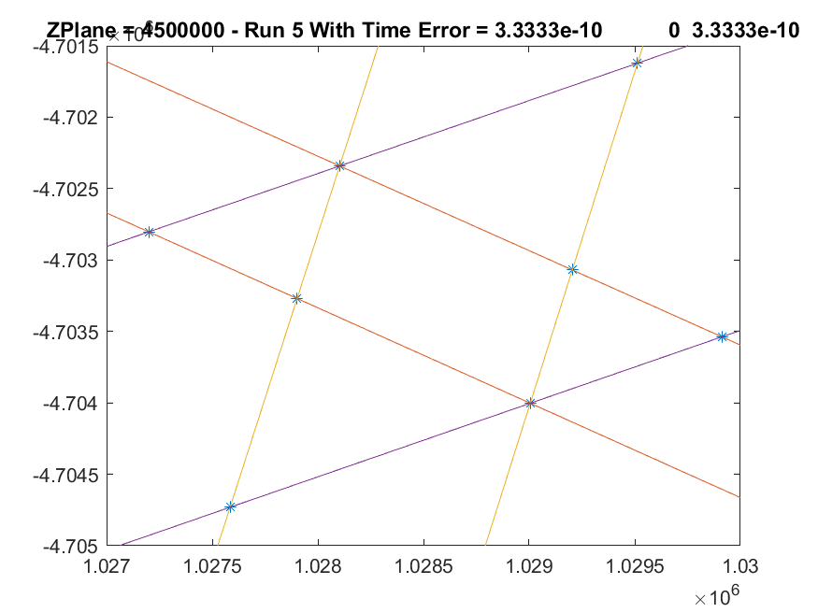
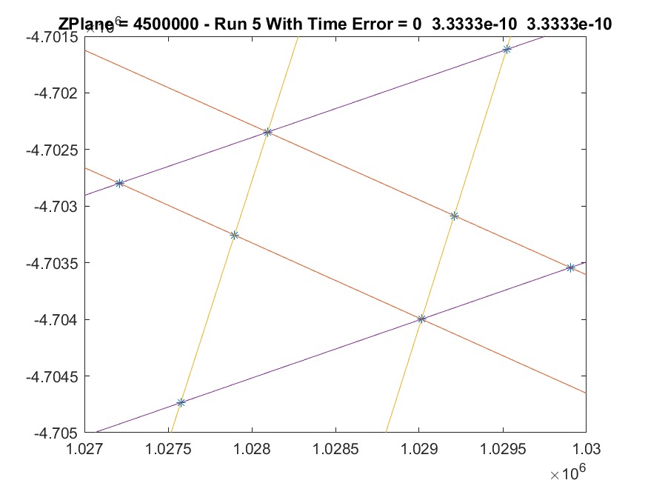
Clock B & C Error. Press, Pull

Slide 45
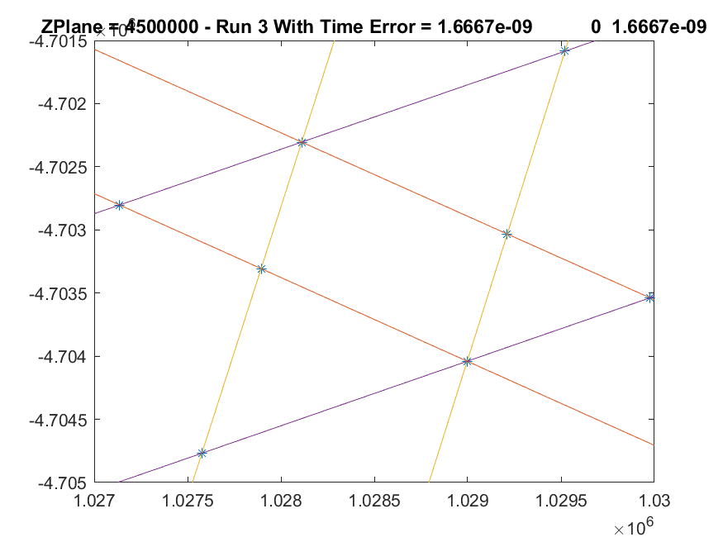

Clock B & C Error. Press, Pull

Slide 46

Location Error in A. Static Shift

Slide 47

Location Error in A. Static Shift

Slide 48

One at a time Plot

Slide 49

Derived Sensitivities
Parameter | Sensitivity (rad/m) & (rad/s)
$$x_{a}$$ | 9.60E-05
$$y_{a}$$ | 4.58E-04
$$z_{a}$$ | 4.27E-04
$$x_{b}$$ | 5.48E-05
$$y_{b}$$ | 2.49E-04
$$z_{b}$$ | 2.56E-04
$$x_{c}$$ | 6.16E-05
$$y_{c}$$ | 2.91E-04
$$z_{c}$$ | 2.99E-04
$$t_{a}$$ | 4.92E+05
$$t_{b}$$ | 1.13E+06
$$t_{c}$$ | 1.24E+06
Using “total error”

Slide 50
Next Steps
For Thursday:
Input a ground track into the simulator.
Estimate the sensitivities at each point in the ground track
Needed Inputs:
Ground Track from Orekit
Conservative uncertainties for Location Err. And Time Sync Error.

Slide 51
Next Steps
Coming down the pipe:
Using 4 stations to yield an average direction.
Montecarlo. Allow all uncertainties to vary simultaneously
Updates to logic in TDoA when finding points.
Way in the future
Reexamine solving for a point via 4 stations.
Train a convolutional neural network to solve for the location of the satellite
(my Machine Intelligence Term project)

